Slide 1
Prediction on age groups based on face images
Ruoyun Chen, Yijia Hao

Slide 2

Introduction
Dataset: UTKFace dataset is a large-scale face dataset with long age span (range from 1 to 116 years old). The dataset consists of over 20,000 face images with annotations of age, gender, and ethnicity.
Goal: The goal of the project is to output the age group of an input image with UTKFace dataset.

Slide 3
Data Sample

Slide 4
Data cleaning
Cut off data number to 3500 on each of the age group
Normalization on pixels

Slide 5
Data-Preprocessing

Slide 6
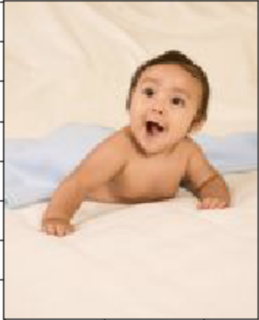

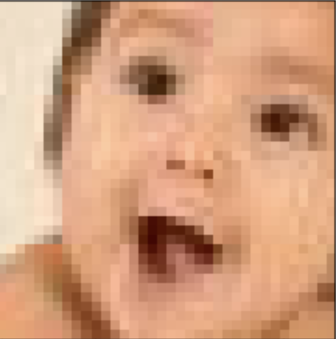
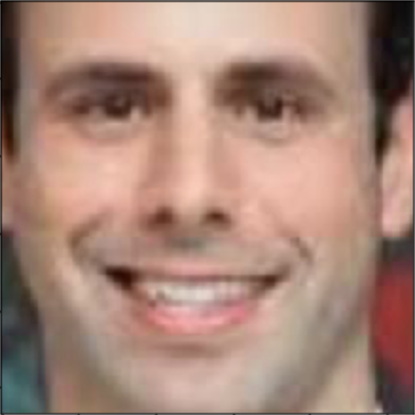
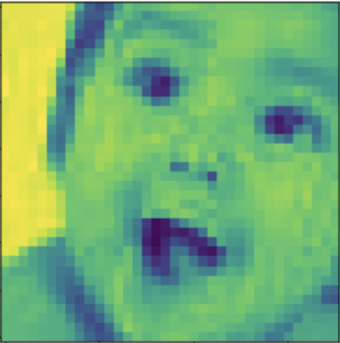

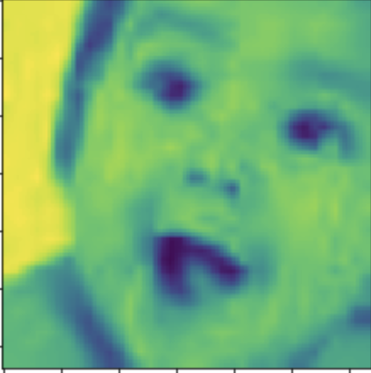
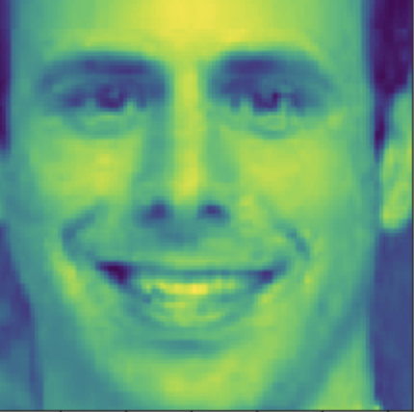
Face extraction
Convert color
preprocessing
resize

Slide 7
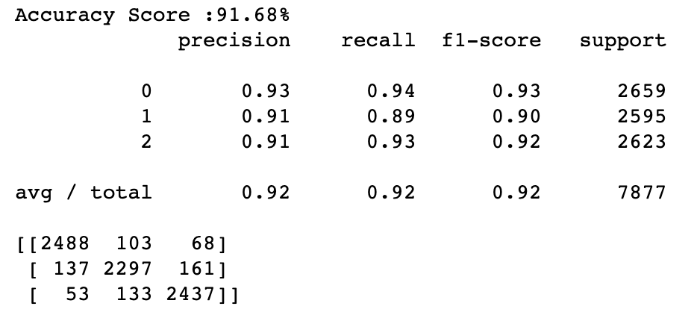
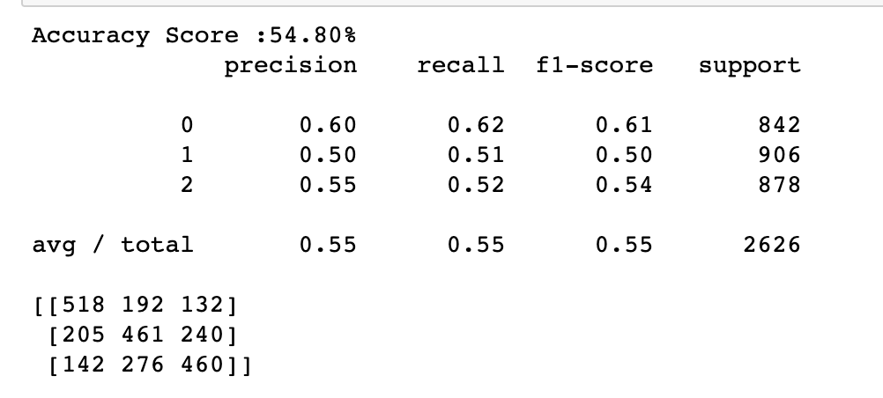
Logistic Regression
Training set vs. Test set

Slide 8
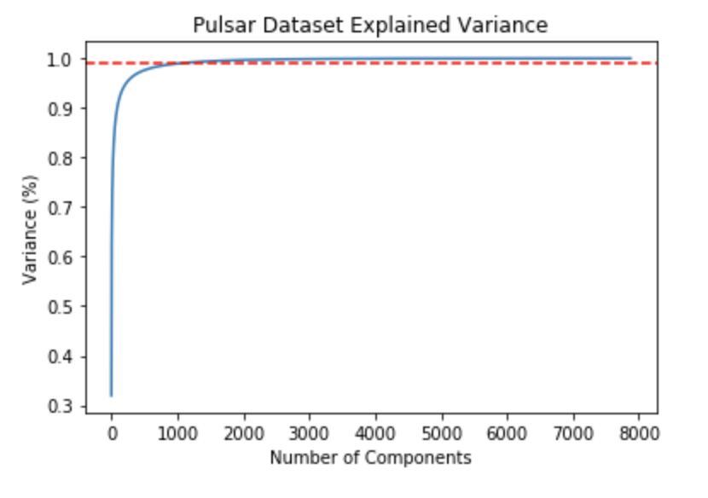
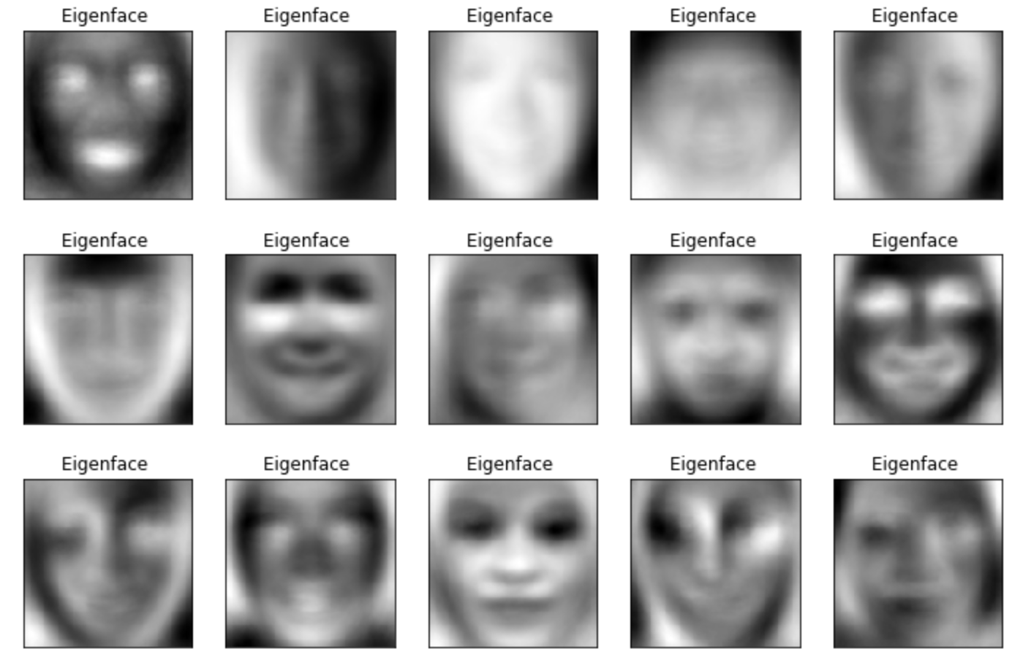
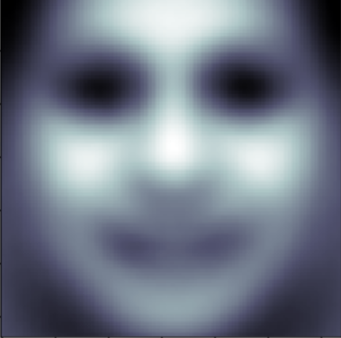
PCA
Eigenfaces
Some of Eigenfaces
Mean Eigenface

Slide 9
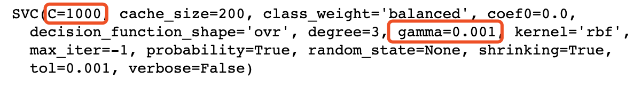
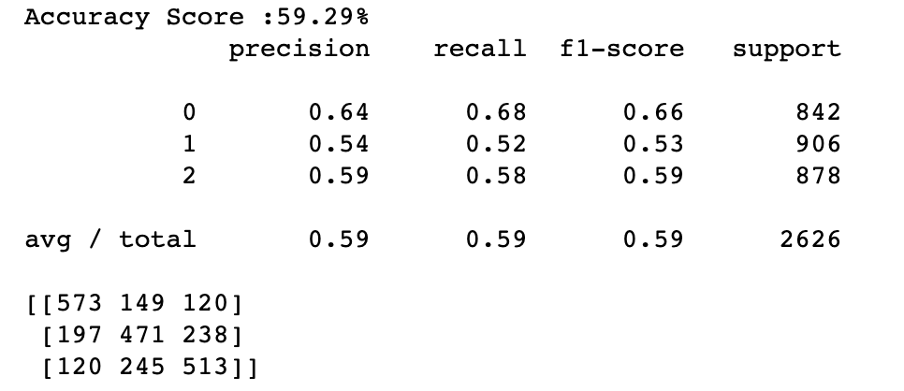
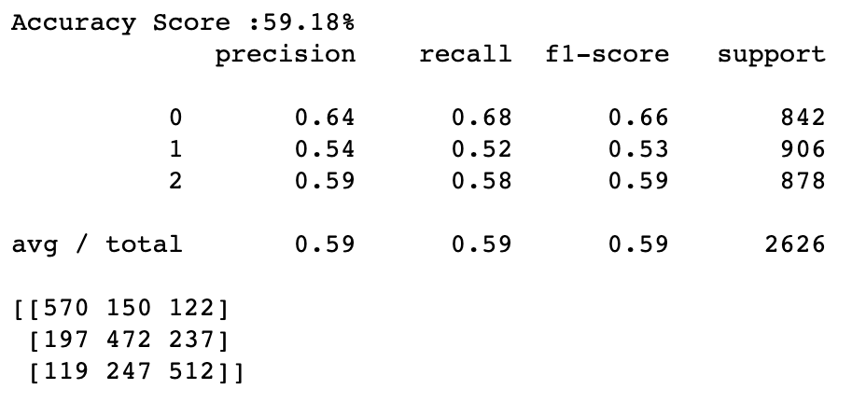
SVM
Training set vs. Test set

Slide 10
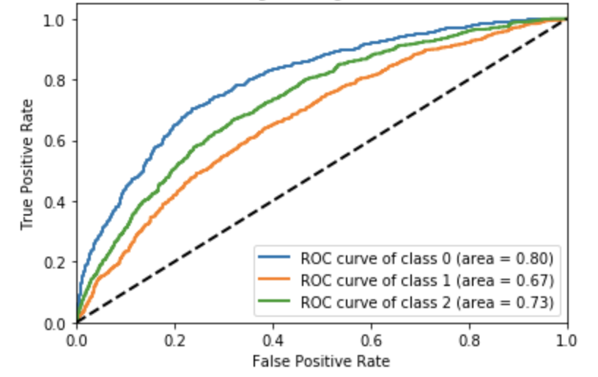
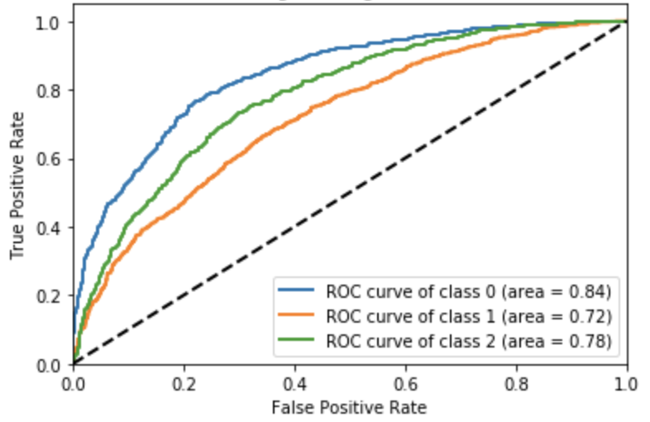
ROC comparison
Logistic Regression to multi-class
SVM to multi-class

Slide 11
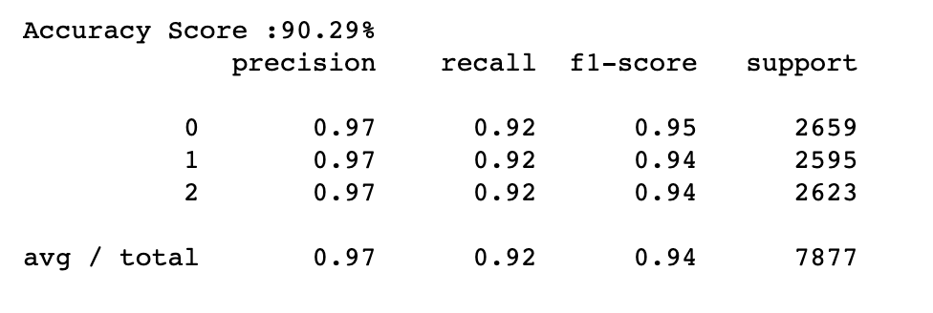
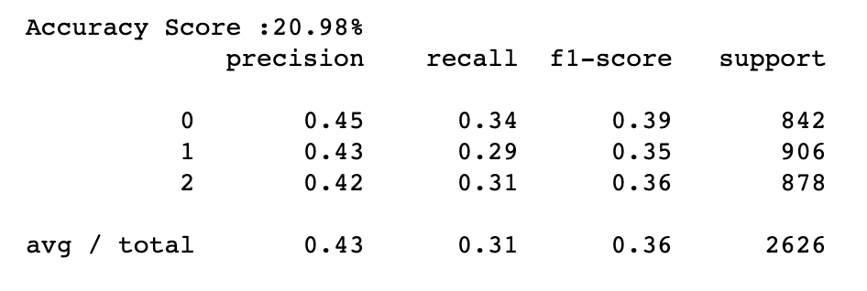
Random Forest
Training set vs. Test set
Trees num: 5, max depth = 50

Slide 13
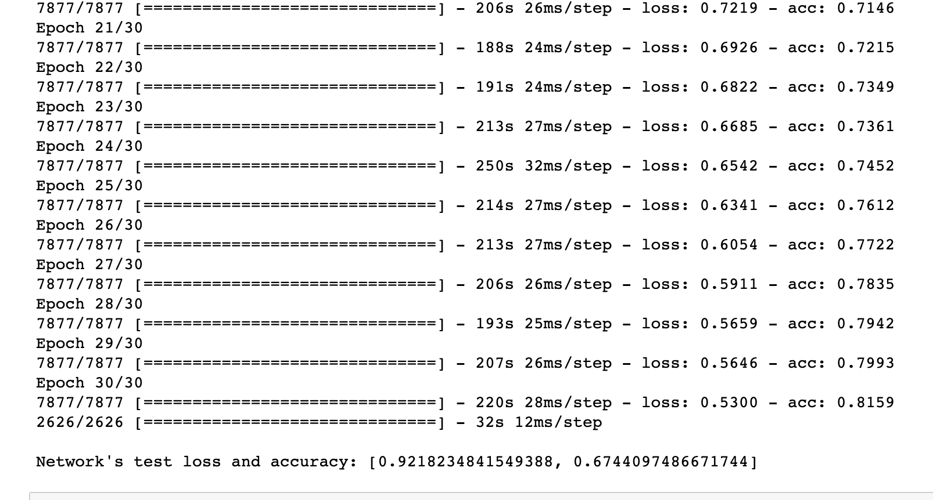
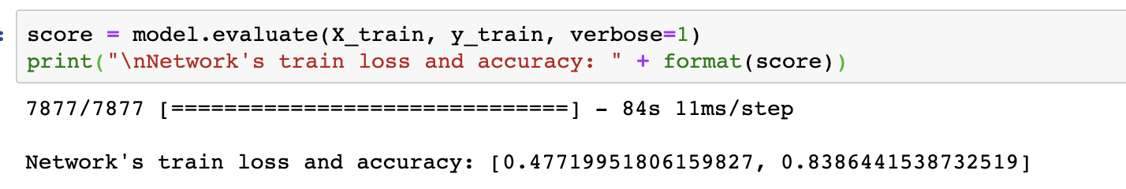
CNN accuracy
Epoch = 20
Batch size = 512
Regularization lambda = 0.01
Stochastic Gradient Descent (learning rate = 0.01)

Slide 14
Future Work
Use ensemble method on CNN model
01
Work on gender classification based on the same dataset
02
Do more research to improve the accuracy of CNN and SVM models
03

Slide 15
Q &A

